Slide 1
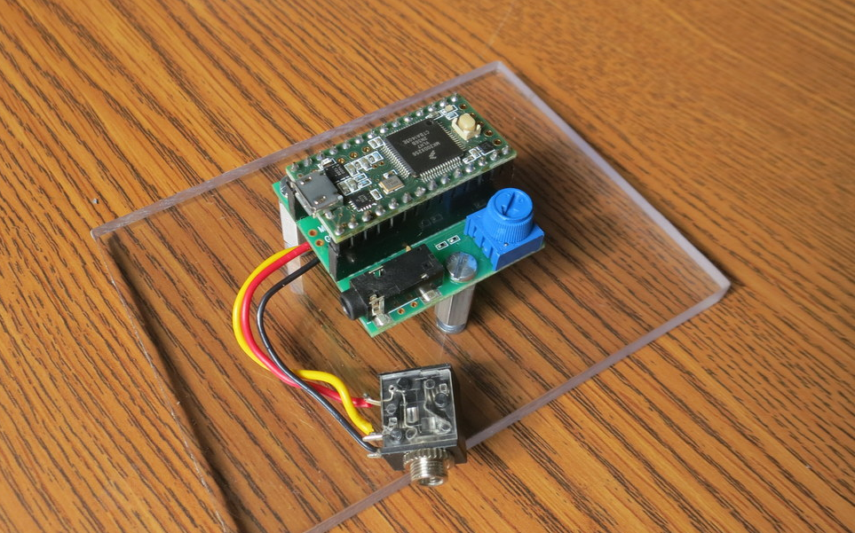
Teensy
3.2
Teensy
Audio Board
I Added This
Line-In Jack

Slide 2
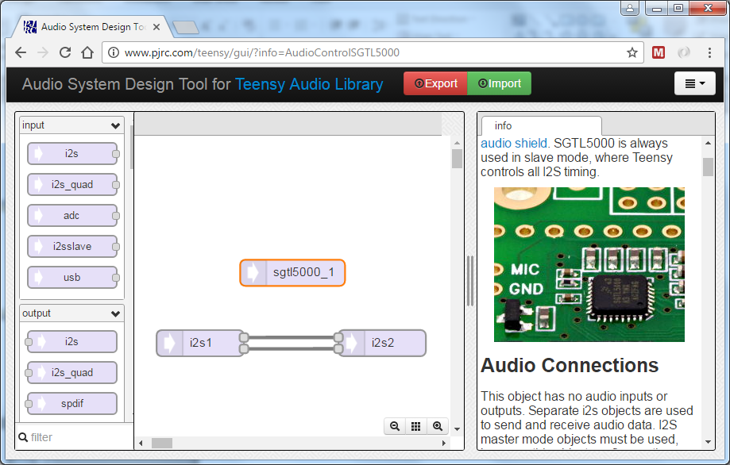
Export
Draw

Slide 3
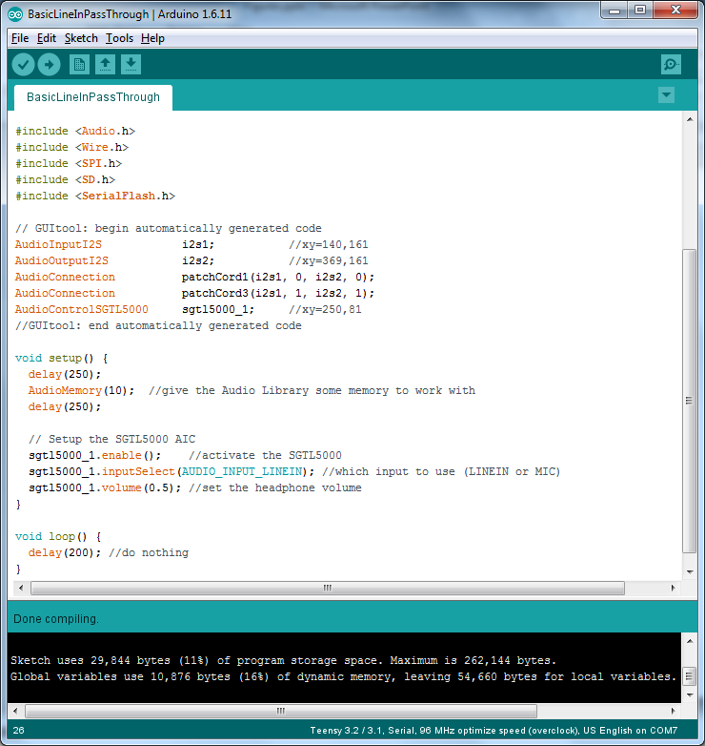
From Teensy
Audio Design
GUI
Add This
Yourself

Slide 4
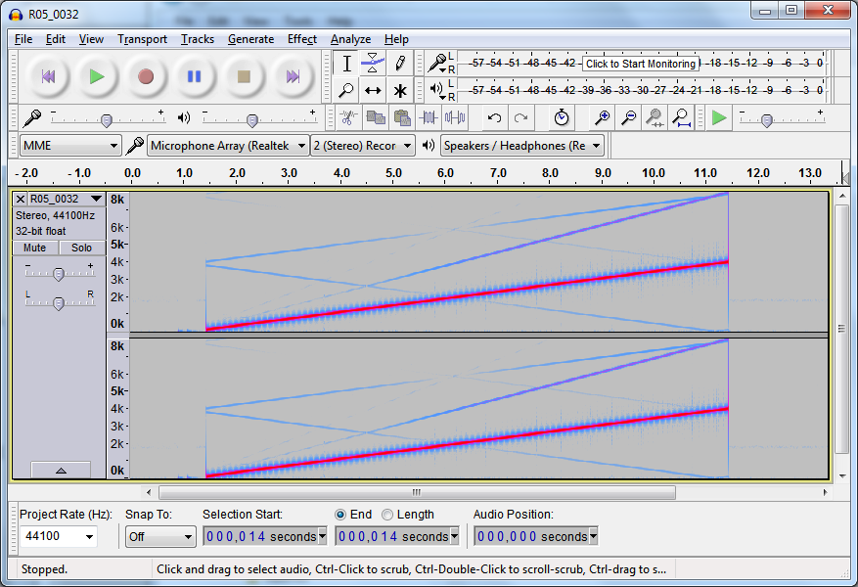

Slide 5
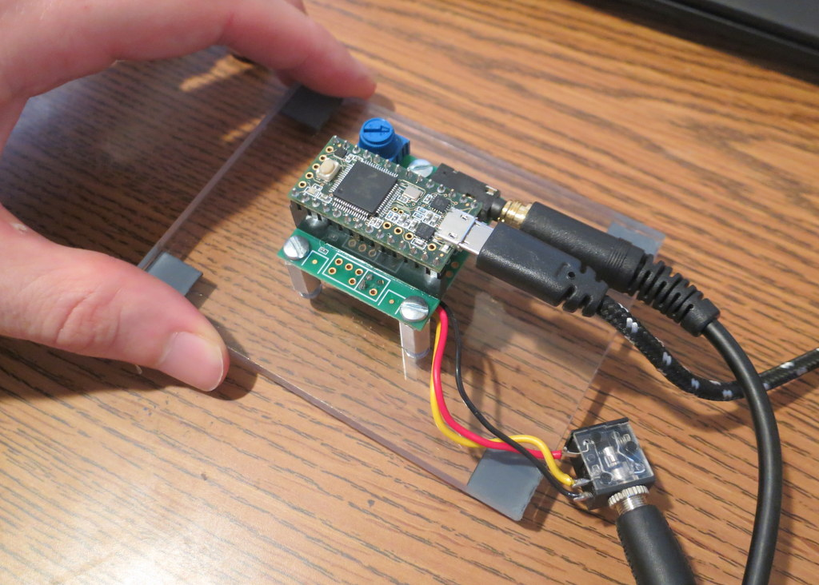
Turn Pot
Teensy 3.2
Headphone
Audio Board
USB
Line-In

Slide 6
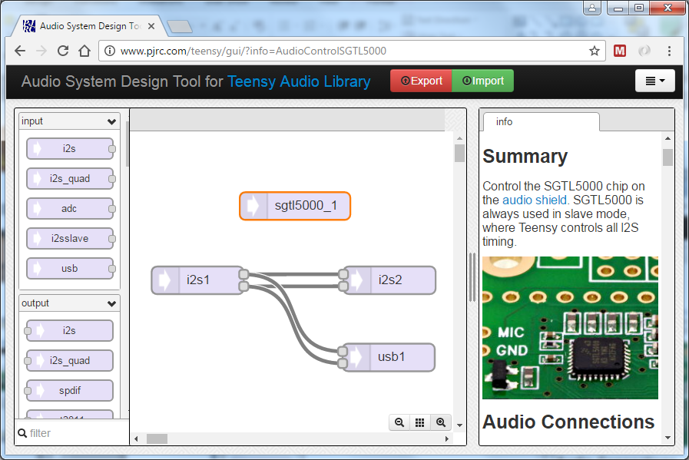
Click!

Slide 7
#include <Audio.h>
#include <Wire.h>
#include <SPI.h>
#include <SD.h>
#include <SerialFlash.h>
// GUItool: begin automatically generated code
AudioInputI2S i2s1; //xy=140,161
AudioOutputUSB usb1; //xy=368,245
AudioOutputI2S i2s2; //xy=369,161
AudioConnection patchCord1(i2s1, 0, i2s2, 0);
AudioConnection patchCord2(i2s1, 0, usb1, 0);
AudioConnection patchCord3(i2s1, 1, i2s2, 1);
AudioConnection patchCord4(i2s1, 1, usb1, 1);
AudioControlSGTL5000 sgtl5000_1; //xy=250,81
// GUItool: end automatically generated code

Slide 8
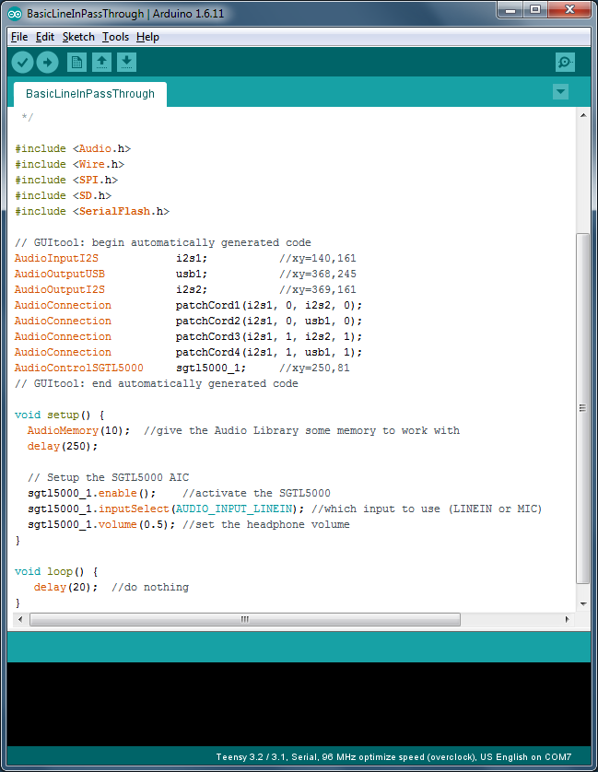

Slide 9
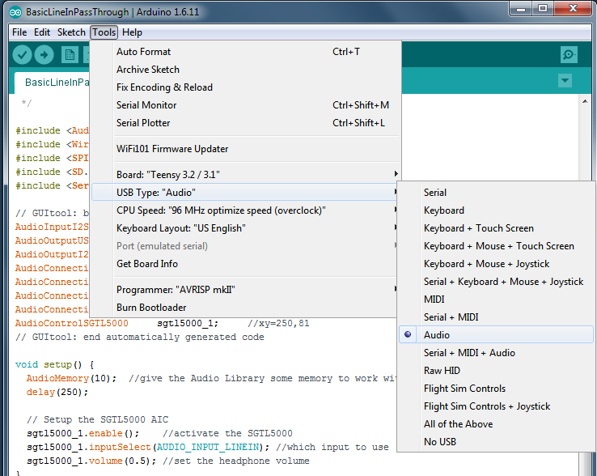

Slide 10
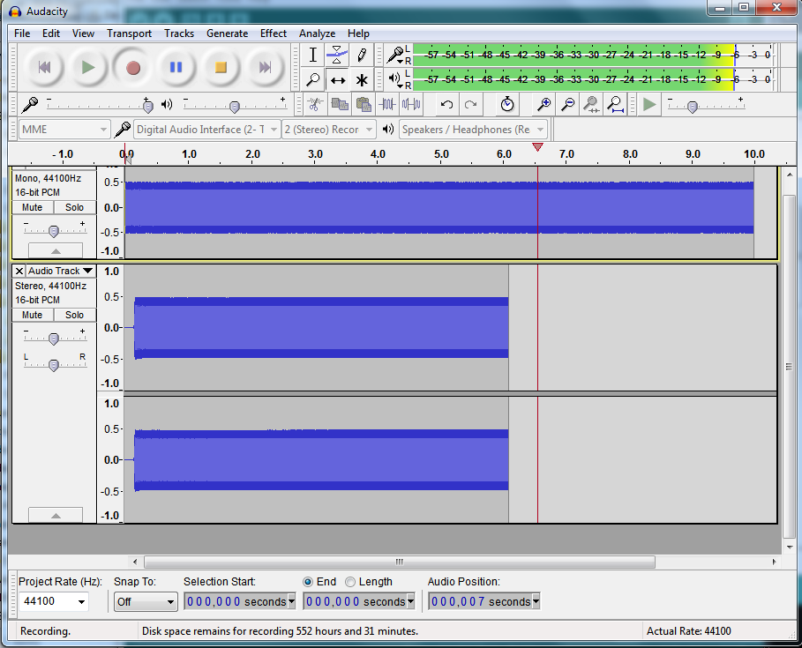
Change to MME
Change to Teensy
Test Signal to Teensy
Audio from Teensy USB
Change to 44100

Slide 11
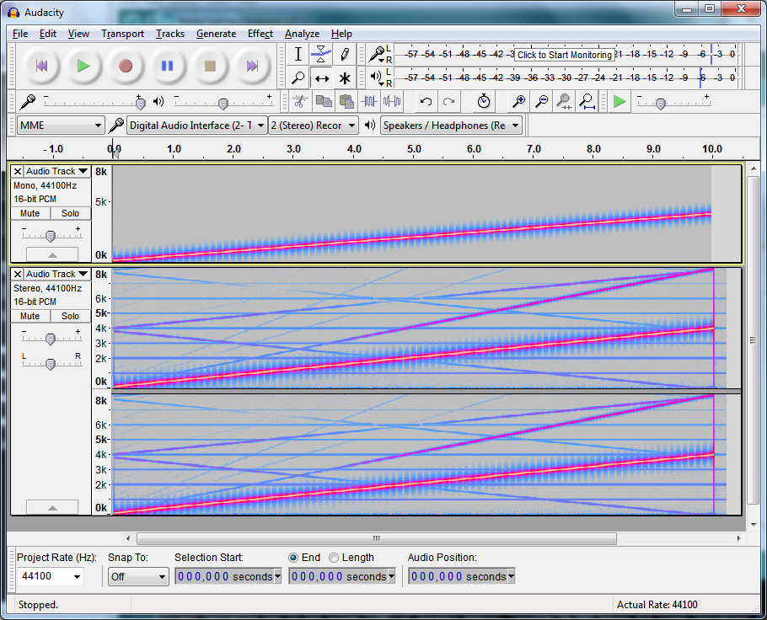
Test Signal to Teensy
Audio from Teensy USB

